Slide 1


Modern Methods in Associative Memory AM and Broader ML|AI — Parikshit Ram IBM Research
Notes:
...

Slide 2

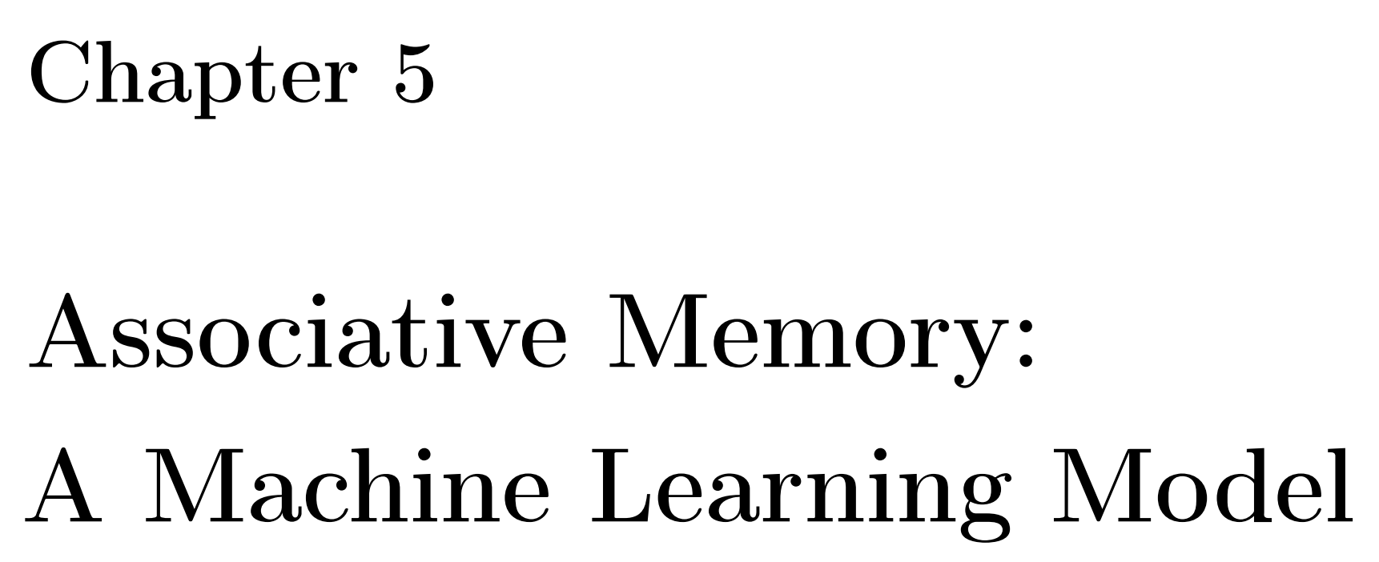
How to think about Associative Memory Networks as a Machine Learning Model? How to use them for standard Machine Learning tasks?
Krotov, et al. "Modern Methods in Associative Memory." 2025.

Slide 3
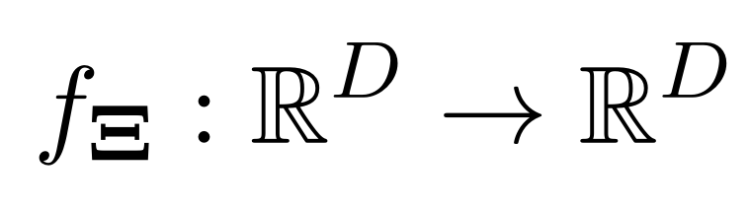
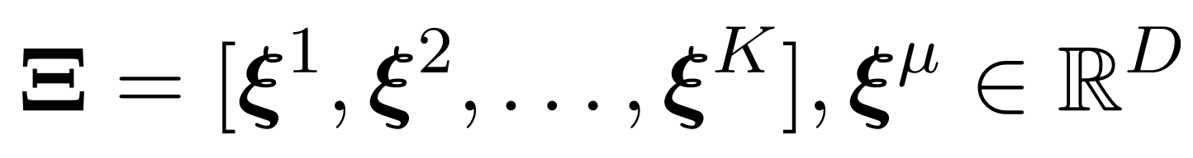
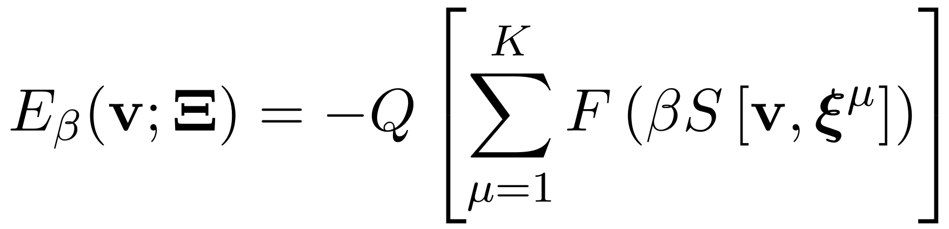
Associative Memory Networks
Model is parameterized with stored patterns
Energy function defines the "model architecture"
Monotonic function
Separation function
Similarity b/w state & memory
Krotov & Hopfield. "Dense Associative Memories for Pattern Recognition." NeurIPS 2016.
Notes:
...

Slide 4
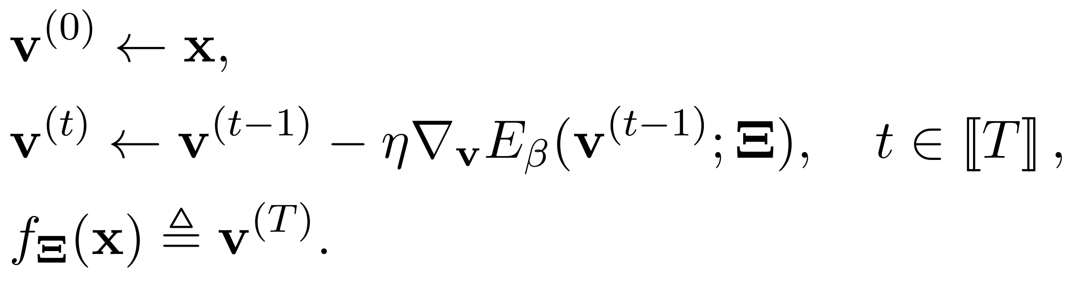
Associative Memory Networks
Inference (or the forward pass) with a T-layer AM network is equivalent to T energy descent steps using the energy gradient.
Krotov & Hopfield. "Dense Associative Memories for Pattern Recognition." NeurIPS 2016.
Notes:
...

Slide 5
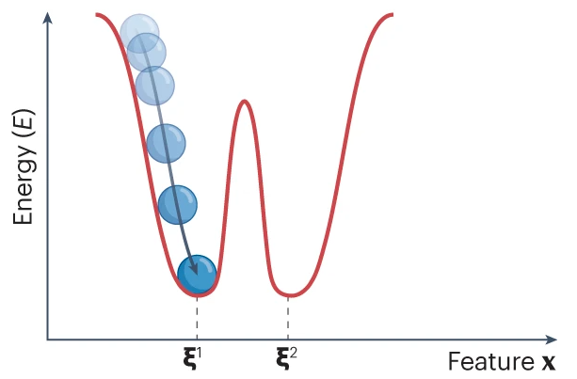
Associative Memory Networks
The energy of any state is inversely related to the probability of the state
Inference via energy minimization – or likelihood maximization
Krotov. "A New Frontier for Hopfield networks." Nature Reviews Physics (2023).
Notes:
...

Slide 6
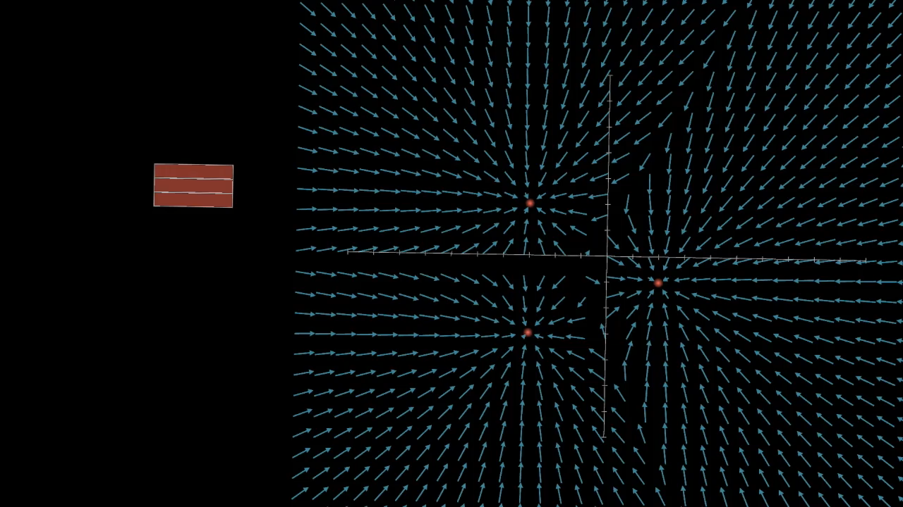
Associative Memory Networks
More memories lead to more local minima of the energy up to a point
More memories – more parameters – potentially more expressive model
Hoover, et al. "Dense Associative Memories through the Lens of Random Features." NeurIPS 2024.
Notes:
...

Slide 7
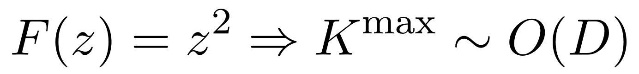
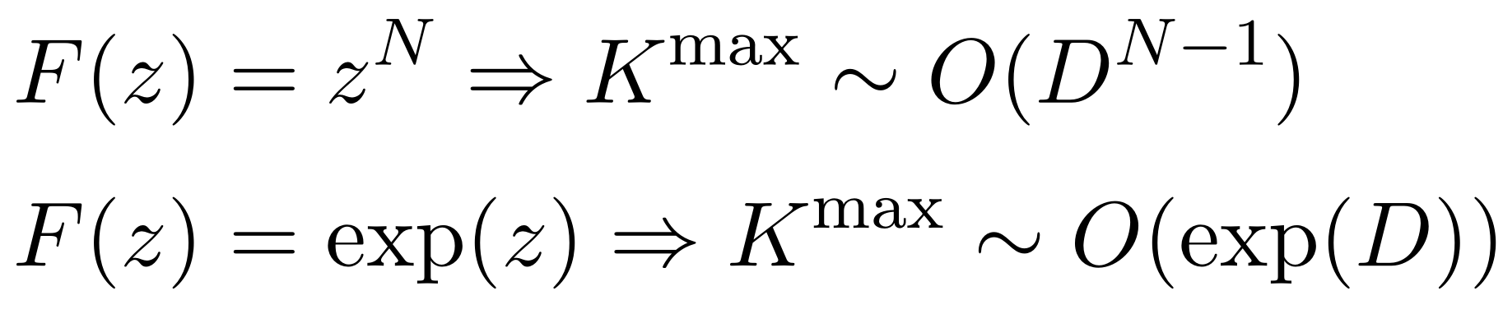
Memory Capacity
The number of memories that can form distinct local minima of the energy
Classical Associative Memory
More memory capacity -- more model expressivity
Dense Associative Memory
But increased computational overhead!
Krotov. "A New Frontier for Hopfield networks." Nature Reviews Physics (2023).
Notes:
...

Slide 8
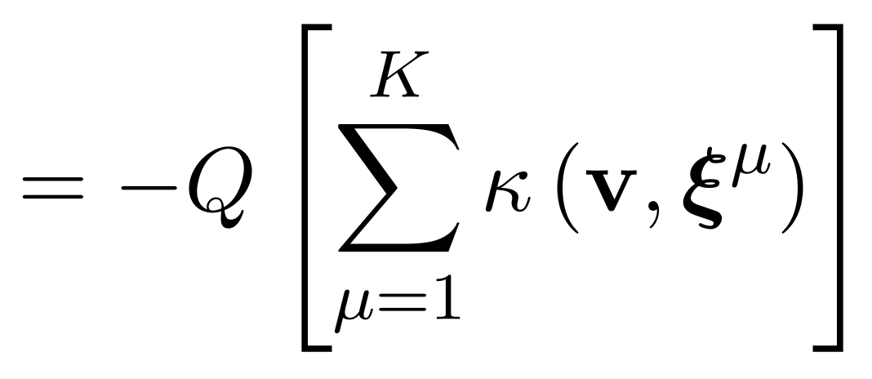
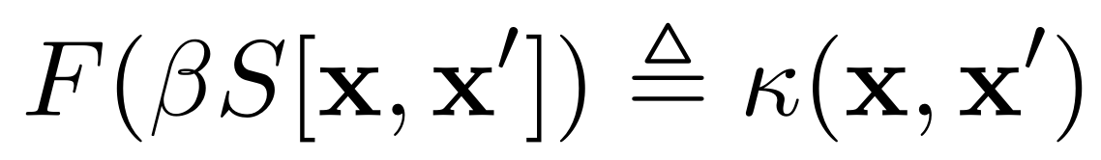
Energy is a Kernel Sum
Kernel sum
Notes:
...

Slide 9
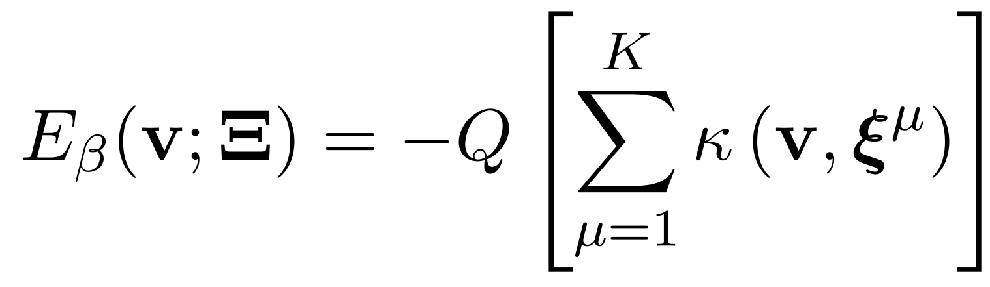
AMs and Kernel Machines
Both nonparametric
Kernel machines
Inference with a single kernel sum (usually)
Associative Memory networks
AM can be parametric
Kernel sum computes energy & inference via energy descent
Single inference (usually) needs multiple kernel sums
Need ability to differentiate through the kernel sums
Kernel sum
Notes:
...

Slide 10
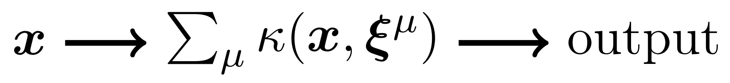
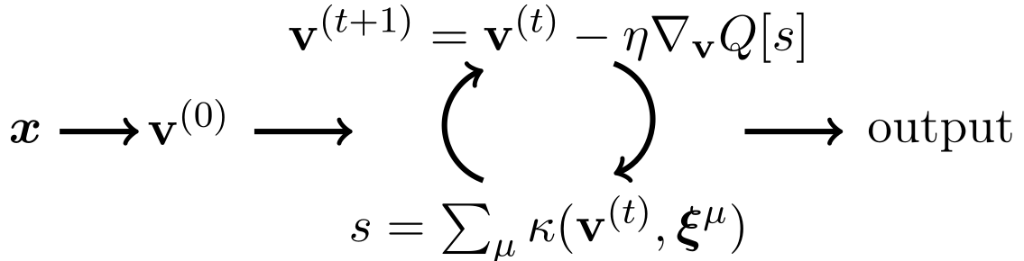
AMs and Kernel Machines
Kernel machines
Kernel sum
Associative Memory networks
Notes:
...

Slide 11
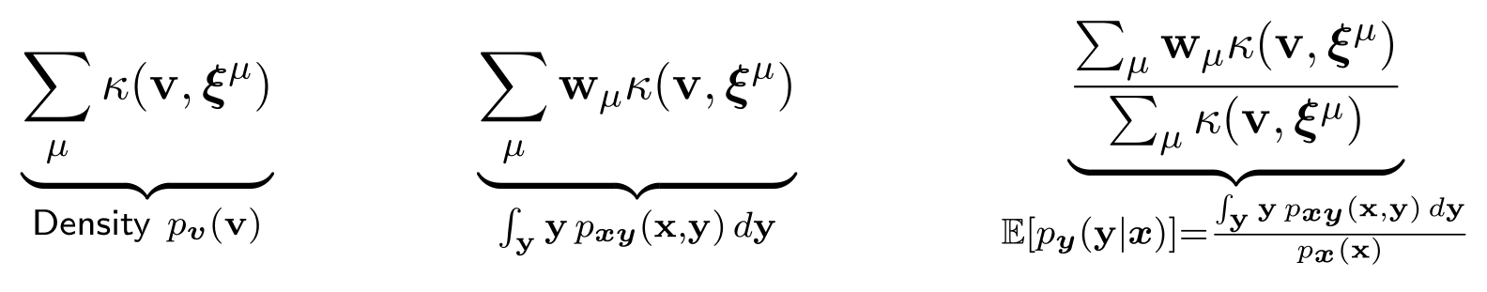
AMs and Kernel Machines
Kernel machines
Kernel machines can compute the expectation of the conditional distribution.
Notes:
...

Slide 12
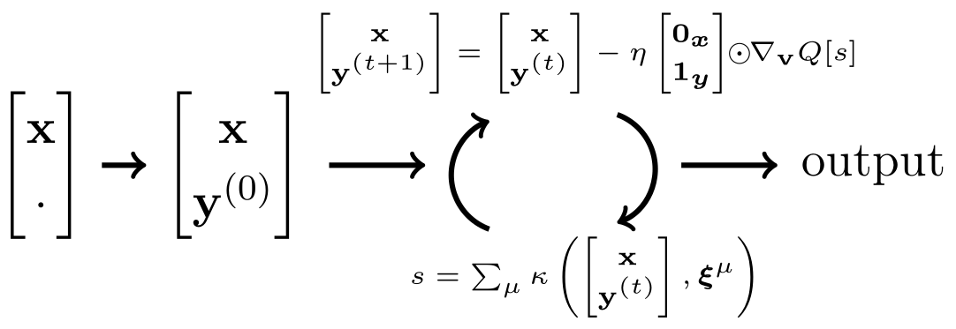
AMs and Kernel Machines
Associative Memory networks
AM networks can find the modes of the conditional distribution.
Notes:
...

Slide 13
AMs and Kernel Machines
Both nonparametric
Kernel machines
O(KD) storage and O(KD) time per inference
Associative Memory networks
O(KD) storage and O(KDT) time per inference for a T-layer AM network
Kernel sum
Notes:
...

Slide 14
Opportunities
Can we draw inspiration from the rich literature on kernel machines?
How can we adapt techniques for efficient kernel machines to AM?
How can we utilize the various domain-specific kernels with unique properties to design novel energy functions, and how do these properties translate to AMs?
What can we do with this "mode-finding" capability of AMs?
Are there other such connections?
How can AMs be used for other ML problems?
Notes:
...

Slide 15
Opportunities
Inspiration for Kernel Machines
Efficiency
Mode-finding Capabilities
Novel Energy Functions
Notes:
...

Slide 16
Opportunities
Inspiration for Kernel Machines
Efficiency
Mode-finding Capabilities
Novel Energy Functions
Notes:
...

Slide 17
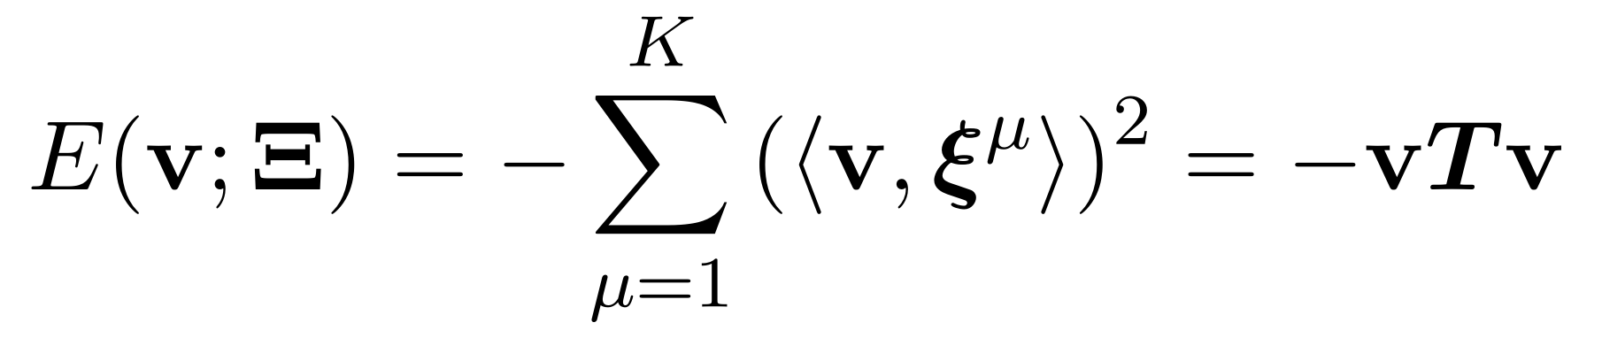
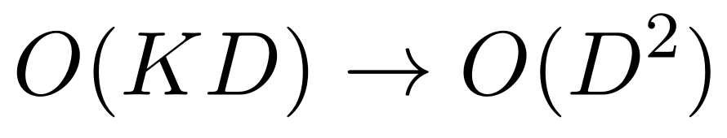
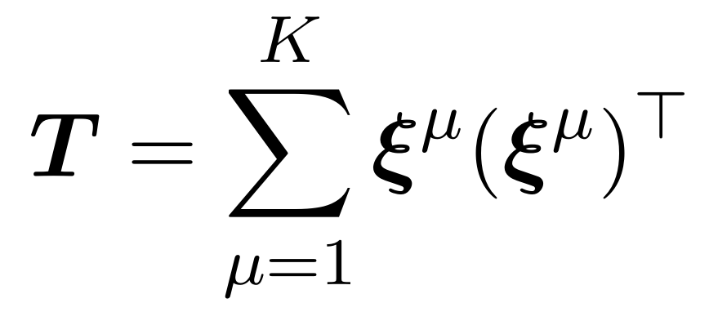
Memory Capacity & Storage
Classical Hopfield energy
Disentangles number of memories from the number of model parameters needed to store them
(sub)Linear capacity
Hopfield. "Neural Networks and Physical Systems with Emergent Collective Computational Abilities." PNAS 1982.
Notes:
...

Slide 18
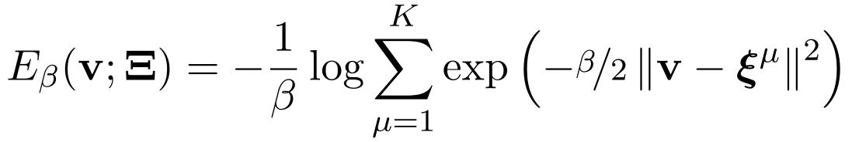
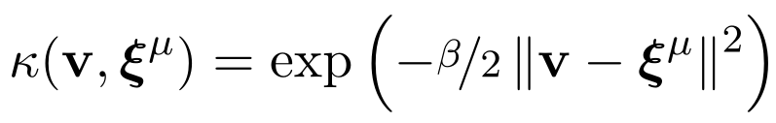
Memory Capacity & Storage
Log-sum-exp energy
Need all memories to compute the energy
Exponential capacity
Demircigil et al. "On a Model of Associative Memory with Huge Storage Capacity." J. Statistical Physics. 2017.
Notes:
...

Slide 19
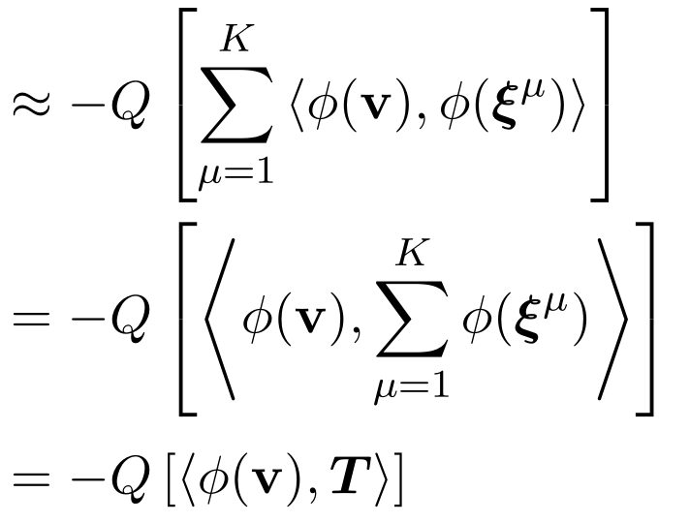
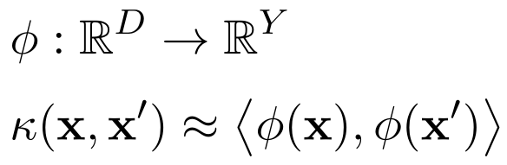
Kernel Feature Maps
MrDAM Memory representation DenseAM
Explicit feature map
DrDAM Distributed representation DenseAM
Hoover, et al. "Dense Associative Memories through the Lens of Random Features." NeurIPS 2024.
Notes:
...

Slide 20
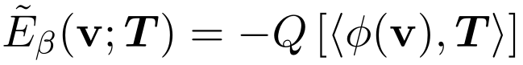
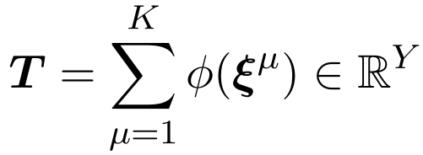
Distributed Memories
MrDAM energy: explicit memories
DrDAM energy: distributed memories
Infeasible infinite dimensional feature map
Hoover, et al. "Dense Associative Memories through the Lens of Random Features." NeurIPS 2024.
Notes:
...

Slide 21
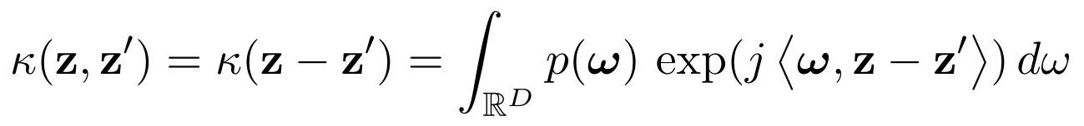
Random Approximate Feature Maps
Bochner's Theorem: A shift-invariant kernel is positive definite if and only it is a Fourier transform of a positive measure
Fourier transform of a positive measure
Shift-invariant
Positive measure
For a positive definite shift-invariant kernel, there exists a such a positive measure
Rahimi & Recht. "Random Features for Kernel Machines." NeurIPS 2007.
Notes:
...

Slide 22
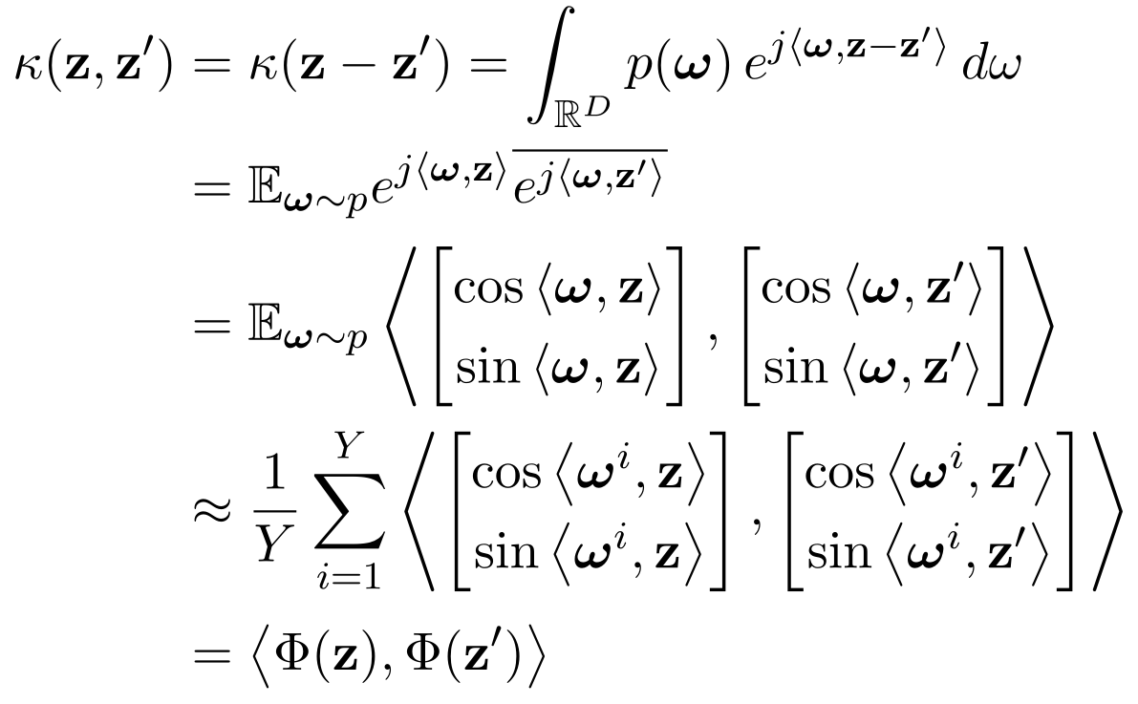
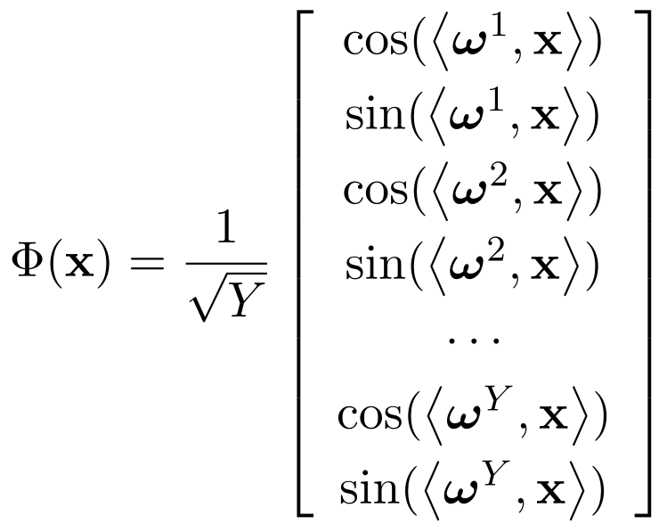
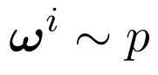
Random Features for Kernel Machines
Random features if we know the positive measure
Rahimi & Recht. "Random Features for Kernel Machines." NeurIPS 2007.
Notes:
...

Slide 23
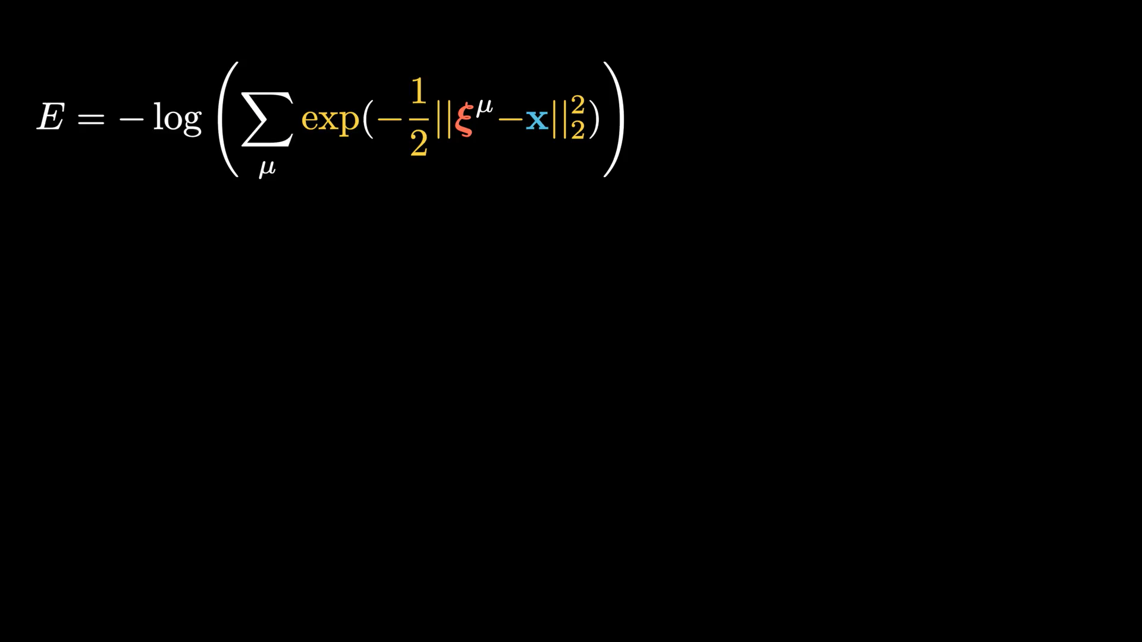
Random Features for Associative Memories
Hoover, et al. "Dense Associative Memories through the Lens of Random Features." NeurIPS 2024.
Notes:
...

Slide 24
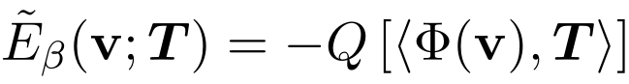
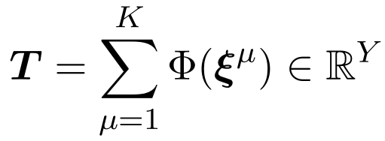
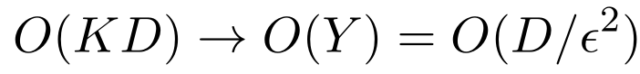
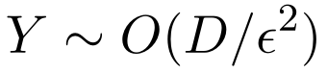
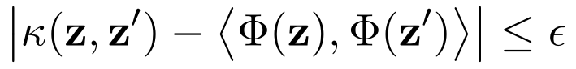
Distributed Memories with Random Features
MrDAM energy: explicit memories
DrDAM energy: distributed memories
Disentangles number of memories from the number of model parameters needed to store them
Hoover, et al. "Dense Associative Memories through the Lens of Random Features." NeurIPS 2024.
Notes:
...

Slide 25
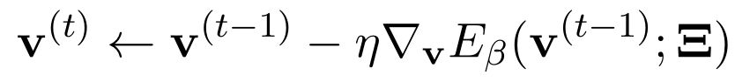
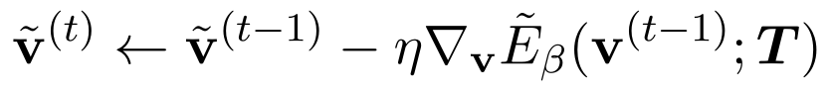
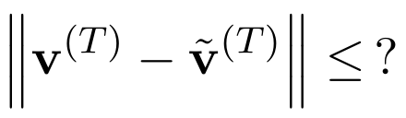
Approximation in Energy Descent
MrDAM energy: exact dynamics
DrDAM energy: approx dynamics
What is the approximation in the DenseAM output?
Hoover, et al. "Dense Associative Memories through the Lens of Random Features." NeurIPS 2024.
Notes:
...

Slide 26
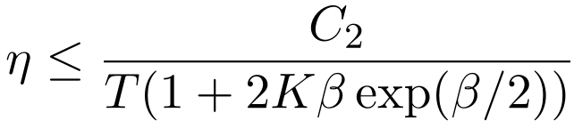
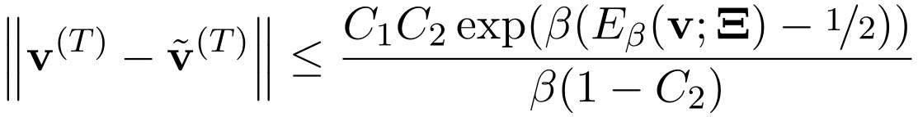
Approximation in Energy Descent
MrDAM energy: exact dynamics
DrDAM energy: approx dynamics
Random feature approx bound
Sufficiently small step-size
Initial energy
Hoover, et al. "Dense Associative Memories through the Lens of Random Features." NeurIPS 2024.
Notes:
...

Slide 27
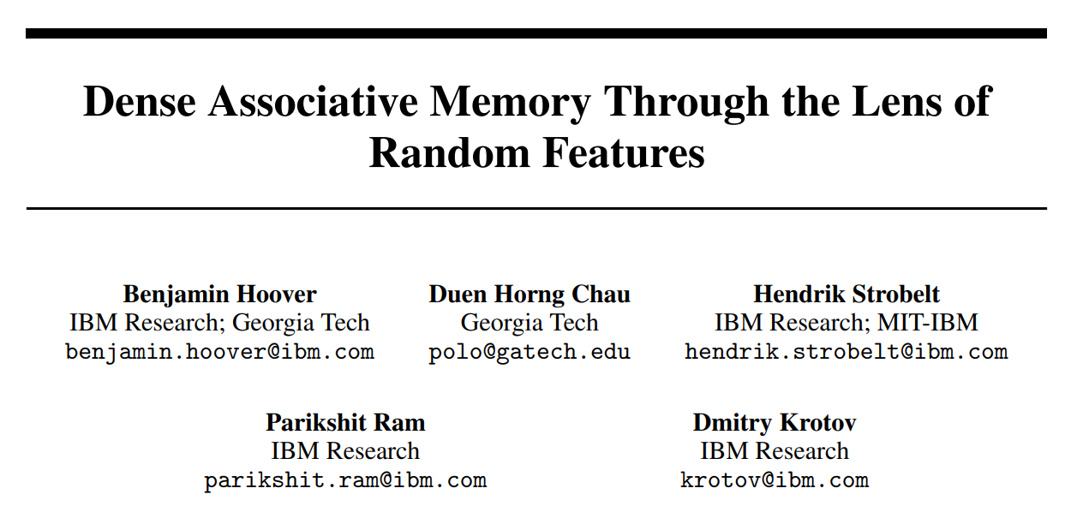

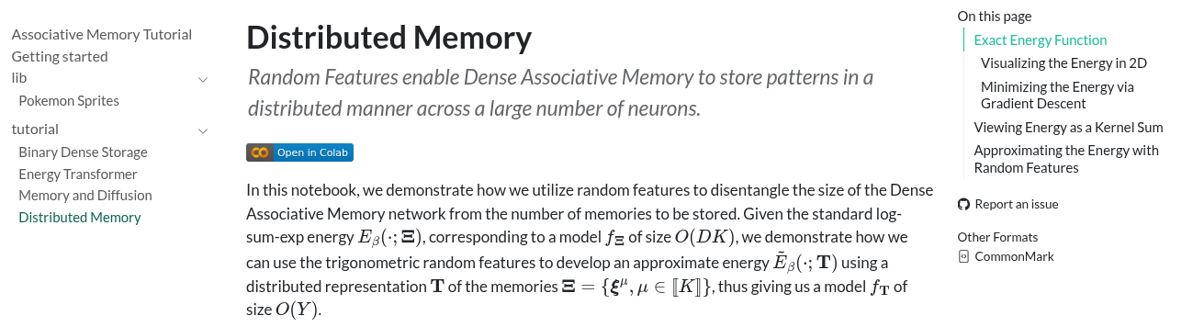
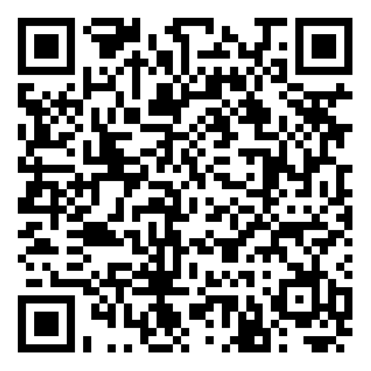
Notes:
...

Slide 28
Opportunities
Inspiration for Kernel Machines
Efficiency
Mode-finding Capabilities
Novel Energy Functions
Notes:
...

Slide 29
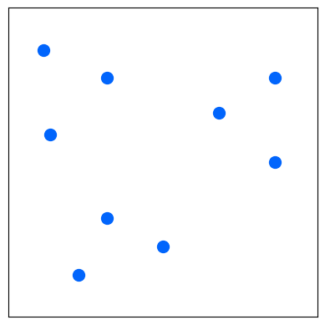
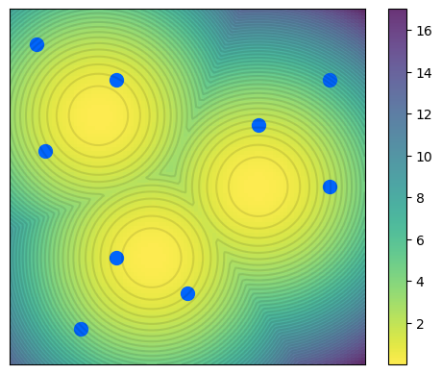
Contractive Layer
Layer operates on inputs independently
But can exhibit collective contraction
Notes:
...

Slide 30
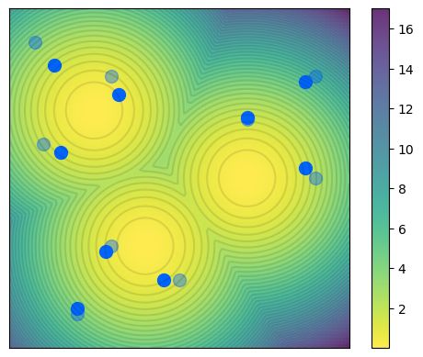
Contractive Layer
Layer operates on inputs independently
But can exhibit collective contraction
Notes:
...

Slide 31
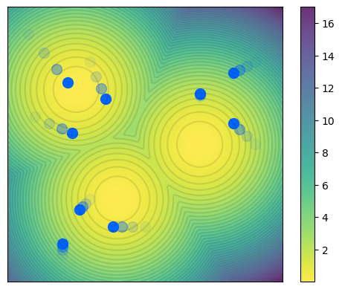
Contractive Layer
Layer operates on inputs independently
But can exhibit collective contraction by contracting towards modes
Notes:
...

Slide 32
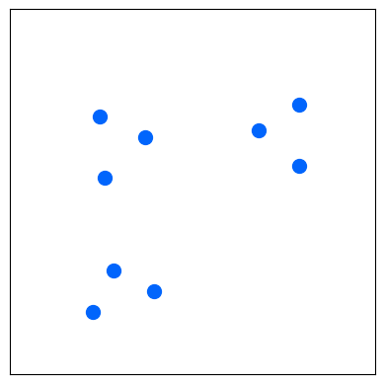
Contractive Layer
Layer operates on inputs independently
But can exhibit collective contraction by contracting towards modes
Notes:
...

Slide 33
Contractive Layer
Parameters of the AM control locations of the minima (modes)
Thus, where the inputs contract towards
Notes:
...

Slide 34
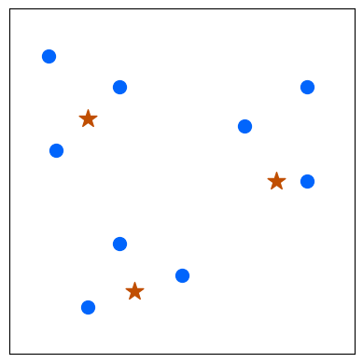
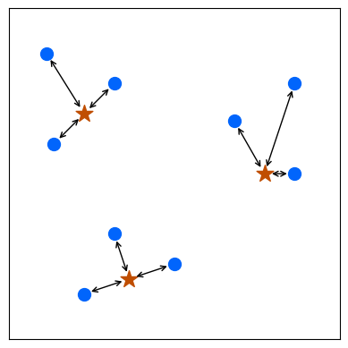

Clustering
Discrete k-means clustering
Points to cluster
Centers
Distance to closest center
Discrete optimization – we need discrete assignments to clusters
Notes:
...

Slide 35



Clustering with Associative Memories
Main idea: Use contraction to emulate discrete assignment
Differentiable discrete clustering objective
Saha, et al. "End-to-End Differentiable Clustering with Associative Memories." ICML 2023.
Notes:
...

Slide 36





Notes:
...

Slide 37








Deep Clustering with Associative Memories
Main idea: Use contraction to learn a clustered latent space
Single differentiable objective handling both fidelity of learned representations and the collective clustered structure
Saha, et al. "Deep Clustering with Associative Memories." NFAM@ICLR 2025.
Notes:
...

Slide 38


Notes:
...

Slide 39
Opportunities
Inspiration for Kernel Machines
Efficiency
Mode-finding Capabilities
Novel Energy Functions
Notes:
...

Slide 40
Energy Functions
Model is parameterized with stored patterns
Energy function defined by the kernel
Gaussian kernel -- the log-sum-exp or LSE energy
Kernel uses exponential separation with exponential capacity
Is that enough to make it a "good" kernel function?
Hoover, et al. "Dense Associative Memory with Epanechnikov Energy." NFAM@ICLR 2025.
Notes:
...

Slide 41




Insights from Density Estimation
Kernel density estimate or KDE given samples from a distribution
Mean Integrated Squared Error
Bias
Variance
Hoover, et al. "Dense Associative Memory with Epanechnikov Energy." NFAM@ICLR 2025.
Notes:
...

Slide 42



Kernels and their Efficiencies
For density estimation
Gaussian kernel is not the best; many other better
Epanechnikov kernel known to be optimal
Hoover, et al. "Dense Associative Memory with Epanechnikov Energy." NFAM@ICLR 2025.
Notes:
...

Slide 43

Log-Sum-Shifted-ReLU or LSR Energy
Exponential capacity without exponential separation function
Simultaneously retrieves memories and generates many new local minima
Hoover, et al. "Dense Associative Memory with Epanechnikov Energy." NFAM@ICLR 2025.
Notes:
...

Slide 44

Log-Sum-Shifted-ReLU or LSR Energy
Exponential capacity without exponential separation function
Simultaneously retrieves memories and generates many new local minima
Hoover, et al. "Dense Associative Memory with Epanechnikov Energy." NFAM@ICLR 2025.
Notes:
...

Slide 45

Epanechnikov Energy and Emergent Memories
Hoover, et al. "Dense Associative Memory with Epanechnikov Energy." NFAM@ICLR 2025.
Notes:
...

Slide 46


Epanechnikov Energy and Emergent Memories
Hoover, et al. "Dense Associative Memory with Epanechnikov Energy." NFAM@ICLR 2025.
Notes:
...

Slide 47



Epanechnikov Energy and Emergent Memories
Hoover, et al. "Dense Associative Memory with Epanechnikov Energy." NFAM@ICLR 2025.
Notes:
...

Slide 48



Epanechnikov Energy and Emergent Memories
Hoover, et al. "Dense Associative Memory with Epanechnikov Energy." NFAM@ICLR 2025.
Notes:
...

Slide 49




Notes:
...

Slide 50
How to think about Associative Memory Networks as a Machine Learning Model? How to use them for standard Machine Learning tasks?
Krotov, et al. "Modern Methods in Associative Memory." 2025.

Slide 51
Thank You!
Learn more about our work connecting Associative Memory to various aspects of Machine Learning.

